Slide 1
Micro-Credit Defaulter Model
A case study from a Microfinance Institution providing mobile financial services to low income families

Slide 2
Problem statement and understanding
Feature engineering and data cleaning
Table of Contents
EDA and visualizations
Model building and metrics
Assumptions, Inferences and Conclusion

Slide 3
Problem statement and understanding
A Microfinance Institution (MFI) is an organization that offers financial services to low income populations. MFS becomes very useful when targeting especially the unbanked poor families living in remote areas with not much sources of income. The Microfinance services (MFS) provided by MFI are Group Loans, Agricultural Loans, Individual Business Loans and so on.
The dataset given is to improve the selection of customers for the credit to predict in terms of a probability for each loan transaction, whether the customer will be paying back the loaned amount within 5 days of insurance of loan.
Here the target is Label, value ‘1’ indicates that the loan has been payed i.e. Non- defaulter, while, Label ‘0’ indicates that the loan has not been payed i.e. defaulter.

Slide 4
Points to Remember:
There are no null values in the dataset.
There may be some customers with no loan history.
The dataset is imbalanced. Label ‘1’ has approximately 87.5% records, while, label ‘0’ has approximately 12.5% records.
For some features, there may be values which might not be realistic. You may have to observe them and treat them with a suitable explanation.
You might come across outliers in some features which you need to handle as per your understanding. Keep in mind that data is expensive and we cannot lose more than 7-8% of the data.

Slide 5
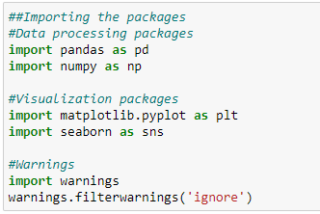
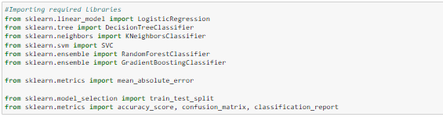
Import Libraries

Slide 6
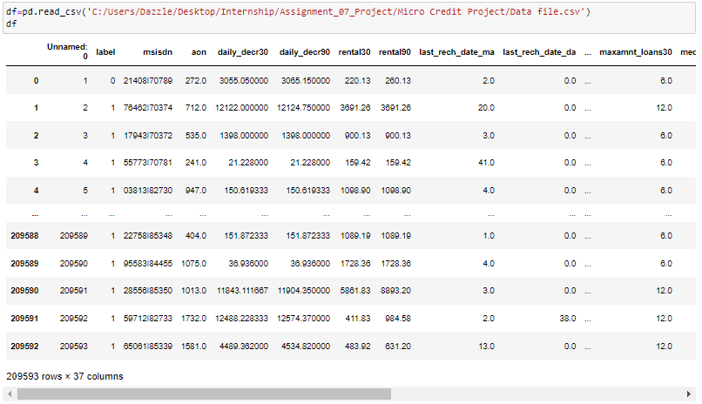
Import dataset
Dataset is having numeric and categorical columns.

Slide 7
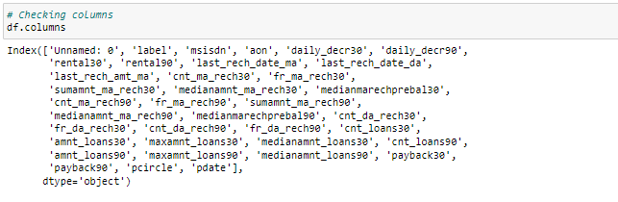
Checking column details
Columns names are displayed where 'label' is the target variable and all other
are independent variables.

Slide 8
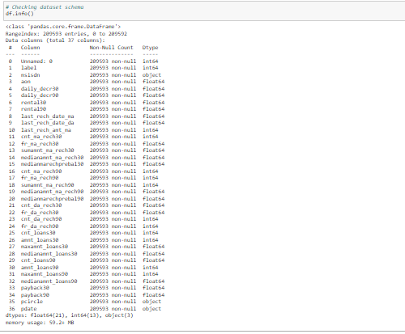
Checking for dataset information
It gives additional information regarding the dataset like RangeIndex, Data columns, datatypes. We could not see null values in the data summary. 'pdate' is date field but it is of object type, hence need to treat this column.

Slide 9
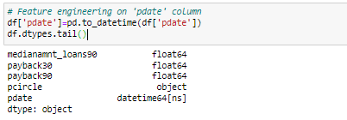
Feature Engineering
Converted the data type of 'pdate' column from object to relevant one.

Slide 10
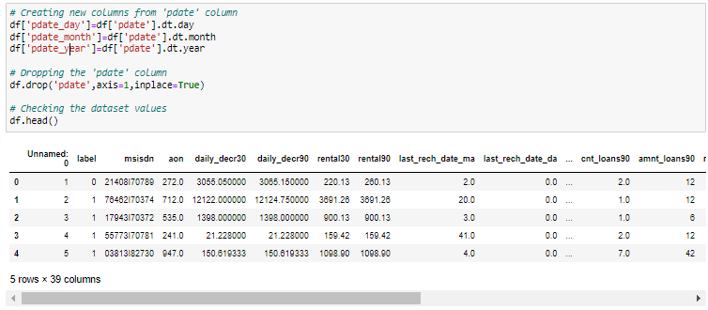
Creating new columns from 'pdate' column

Slide 11
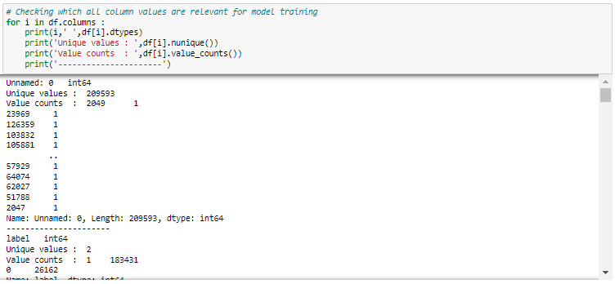
Data Preprocessing
Column 'Unnamed: 0' has 209593 unique values that is equal to total rows. It is just a unique identifier. 'msisdn' (mobile number of user) is of object type and does not seem to have valid values. It does not seem to contribute much for the prediction. 'pcircle' (telecom circle) has just 1 unique value (UPW) of object type. 'pdate_year' has just 1 unique value 2016, hence we can drop all these mentioned columns as there is no significant contribution of these columns to the model predicton.
Target column 'label' has 2 values but value counts have a huge difference hence there is class imbalance issue.

Slide 12
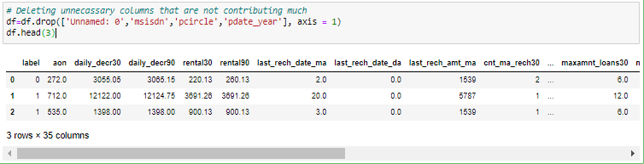
Deleting unnecessary columns that are not contributing much
Removed columns 'Unnamed: 0','msisdn','pcircle','pdate_year.

Slide 13
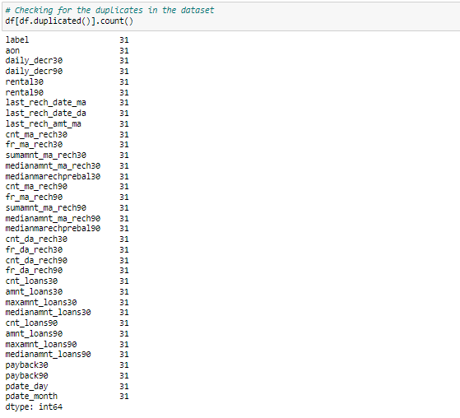
Checking for the duplicates in dataset
There are 31 duplicate rows which needs to be treated.

Slide 14
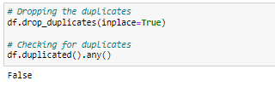
Dropping duplicates
There are no duplicate values in the dataset.

Slide 15

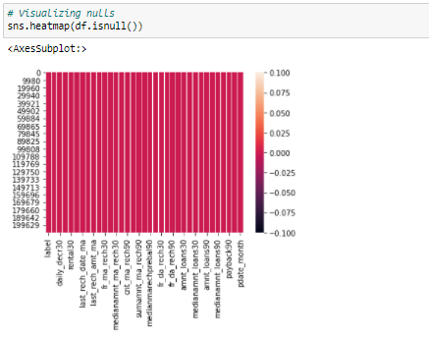
Exploratory Data Analysis and Visualizations
Checking for null values in the dataset
Heatmap showing no null values are present in the dataset.

Slide 16

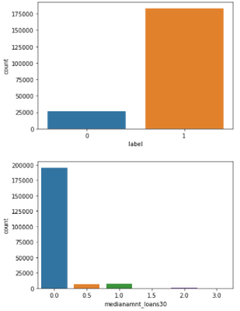
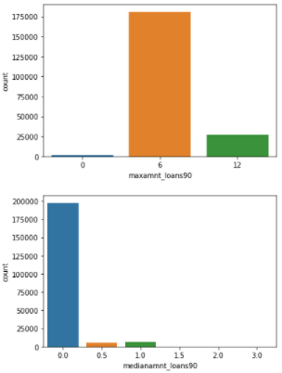
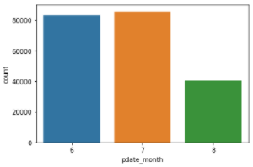
Checking for the value counts using count plot

Slide 17
Inferences from count plot
With the countplot we can see that 'medianamnt_loans30' column has 0.0 Median of amounts of loan taken by the user in last 30 days in majority and other values have very less count comparatively. Column 'maxamnt_loans90' has 6 as maximum amount of loan taken by the user in last 90 days n a very high count and other values comparatively have very less count. Column 'medianamnt_loans90' has 0.0 as Median of amounts of loan taken by the user in last 90 days in a very high count as compared to other values. There are 3 'pdate_months' June, July,August out of which July has highest count followed by June and least count is in August. This kind of distribution could result in skewness.
Column 'label' 1 (Non-defaulter) has a huge count compared to 0 (Defaulter) and since this is a target variable this columns needs class balancing.

Slide 18
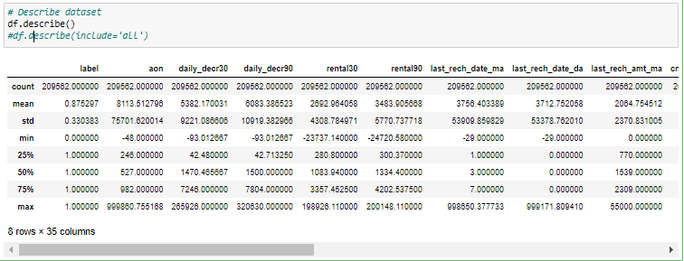
Statistic Summary

Slide 19
Inference
'label' has values 0 and 1, 'aon' ranges from -48 to 999860.755168, 'daily_decr30' ranges from -93.012667 to 265926, 'daily_decr90' ranges from -93.012667 to 320630, 'rental30' ranges from -23737.140000 to 198926.110000, 'rental90' ranges from -24720.580000 to 200148.110000, 'last_rech_date_ma' ranges from -29.000000 to 998650.377733, 'last_rech_date_da' -29.000000 to 999171.809410, 'last_rech_amt_ma' ranges from 0-55000, 'cnt_ma_rech30' ranges from 0-203, 'maxamnt_loans30' ranges from 0-99864.560864, 'medianamnt_loans30' ranges from 0 to 3, 'cnt_loans90' ranges from 0-4997.517944, 'amnt_loans90' ranges from 0-438, 'maxamnt_loans90' ranges from 0-12, 'medianamnt_loans90' ranges from 0-3, 'payback30' ranges from 0-171.500000, 'payback90' ranges from 0-171.500000, 'pdate_day' ranges from 1-31, 'pdate_month' ranges from 6-8.
Columns aon, daily_decr30, daily_decr90, rental30, rental90, last_rech_date_ma, last_rech_date_da, last_rech_amt_ma, maxamnt_loans30, cnt_loans90, amnt_loans90, payback30, payback90 have mean>median hence right skewness is there and the difference between 75% and max values are high for some of the columns hence outliers might be there.
Standard deviation seem high for aon, daily_decr30, daily_decr90, rental30, rental90, last_rech_date_ma, last_rech_date_da, last_rech_amt_ma, maxamnt_loans30, cnt_loans90.

Slide 20
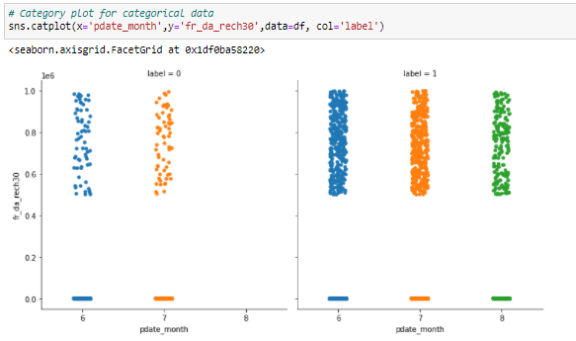
Category plot between pdate_month and fr_da_rech30
Frequency of data account recharged in last 30 days is highest for the users paid back the credit amount within 5 days of issuing the loan that is also highest in July month and lowest in August month. Users did not pay back the credit amount within 5 days of issuing the loan have 0 Frequency of data account recharged in last 30 days and very few in other months.

Slide 21
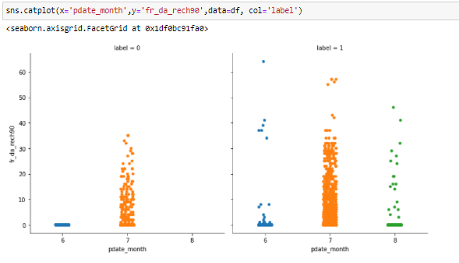
Category plot between pdate_month and fr_da_rech90
Number of times data account got recharged in last 90 days is highest for the users paid back the credit amount within 5 days of issuing the loan in July month and few in other months. Users did not pay back the credit amount within 5 days of issuing the loan have 0 Number of times data account got recharged in last 90 days in August and count is comparatively high in the month of July and very few in June month.

Slide 22
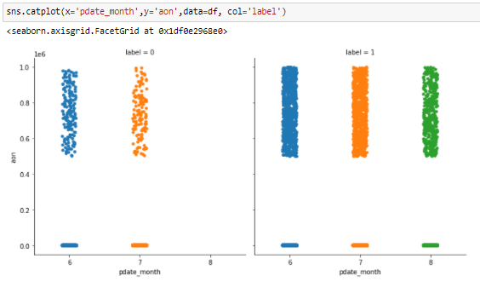
Category plot between pdate_month and aon
Majority of age on cellular network in days is majorly for the users paid back the credit amount within 5 days of issuing the loan and highest n the month of July. Users did not paid back the credit amount within 5 days of issuing the loan have no count in the month of August they lie in June and July months.

Slide 23
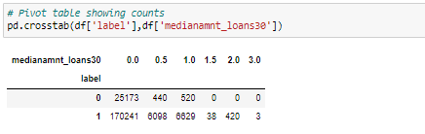
Crosstab showing Pivot table between label and medianamnt_loans30
0.0 as Median of amounts of loan taken by the user in last 30 days has the highest count of the users that paid back and did not paid back the credit amount within 5 days of issuing the loan. There are no user that has not paid back the credit amount within 5 days of issuing the loan with the median amount of 1.5, 2.0 and 3.0 .are mostly used for online purchase.

Slide 24
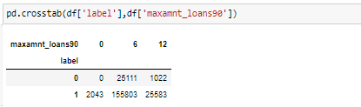
Crosstab showing Pivot table between label and maxamnt_loans90
Maximum amount of loan taken by the users that paid back and did not paid back the credit amount within 5 days of issuing the loan, in last 90 days is highest for 6 as maximum amount followed by 12.

Slide 25
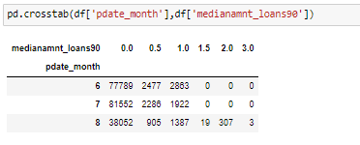
Crosstab showing Pivot table between pdate_month and medianamnt_loans90
Median of amounts of loan taken by the user in last 90 days as 0.0 is highest in all the mentioned months but among these months July has the highest count followed by June and lastly August. Median of amounts of loan taken by the user in last 90 days above 1.0 has no users in the months June and July but August has few count.

Slide 26
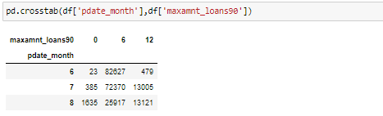
Crosstab showing Pivot table between pdate_month and maxamnt_loans90
Maximum amount of loan taken by the user in last 90 days as 6 has highest count in all the months data given followed by 12 as maximum amount of loan taken by the user in last 90 days and least counts are in 0. Maximum amount of loan of 0 has highest cont in August, Maximum amount 6 has highest count in June and Maximum amount 12 has highest count in August.

Slide 27
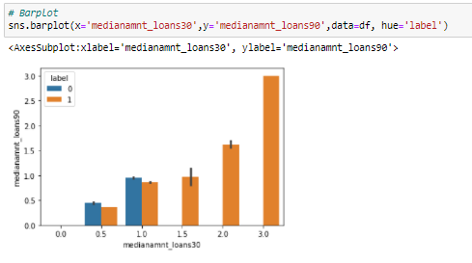
Barplot
Median of amounts of loan taken by the user in last 30 days as 0.5 and 1.0 only has the users who did not pay back the credit amount within 5 days of issuing the loan having higher Median of amounts of loan taken by the user in last 90 days comparatively. There are no users in 0.0 as medianamnt_loans30 and medianamnt_loans90. There are no users who did not pay back the credit amount within 5 days of issuing the loan in medianamnt_loans30 above 1.0.

Slide 28
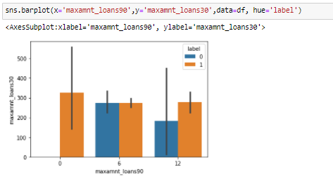
Barplot
There are no users who did not pay back the credit amount within 5 days of issuing the loan where maxamnt_loans90 is 0. maxamnt_loans30 is highest for 0 as maxamnt_loans90 where all the users have paid back the credit amount within 5 days of issuing the loan.

Slide 29
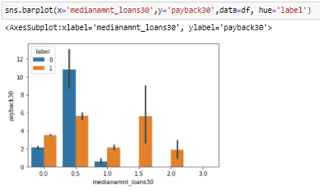
Barplot
Median of amounts of loan taken by the user in last 30 days above 1.0 has no users who did not pay back the credit amount within 5 days of issuing the loan, they lie in the range of 0 to 1. Users who did not pay back the credit amount within 5 days of issuing the loan has highest Average payback time in days over last 30 days at medianamnt_loans30 as 0.5.

Slide 30
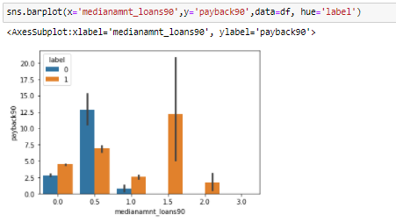
Barplot
Median of amounts of loan taken by the user in last 90 days above 1.0 has no users who did not pay back the credit amount within 5 days of issuing the loan, they lie in the range of 0 to 1. Users who did not pay back the credit amount within 5 days of issuing the loan has highest Average payback time in days over last 90 days at medianamnt_loans30 as 0.5. Users who paid back the credit amount within 5 days of issuing the loan has highest payback90 when medianamnt_loans90 is 1.5.

Slide 31
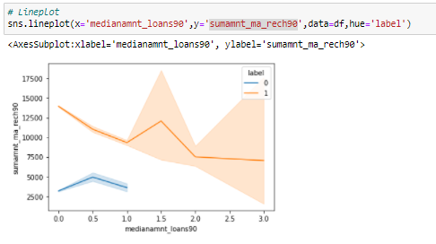
Lineplot showing relation between medianamnt_loans90 and sumamnt_ma_rech90
Total amount of recharge in main account over last 90 days (in Indonasian Rupiah) decreases with increase in Median of amounts of loan taken by the user in last 90 days with a hike in between where Median of amounts of loan taken by the user in last 90 days is 1.5 for the users paid back the credit amount within 5 days of issuing the loan. For the users did not pay back the credit amount within 5 days of issuing the loan medianamnt_loans90 lies between 0.0 to 1.0 and sumamnt_ma_rech90 first increases till the peak and then again decreases. sumamnt_ma_rech90 has a huge difference of amounts for the defaulters and non-defaulters.

Slide 32
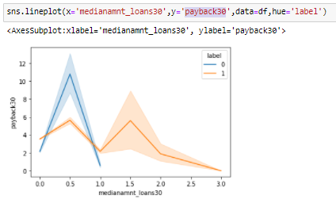
Lineplot showing relation between medianamnt_loans30 and payback30
Average payback time in days over last 30 days decreases with increase in Median of amounts of loan taken by the user in last 30 days with hikes in between where Median of amounts of loan taken by the user in last 30 days is 0.5 and 1.5 for the users paid back the credit amount within 5 days of issuing the loan. For the users did not pay back the credit amount within 5 days of issuing the loan Average payback time in days over last 30 days lies between 2 to 12 and medianamnt_loans30 lies between 0.0 to 1.0 and payback30 first increases till the peak and then again decreases.

Slide 33
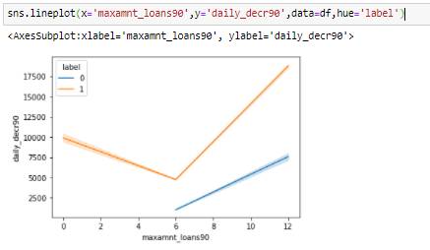
Lineplot showing relation between maxamnt_loans90 and daily_decr90
Daily amount spent from main account, averaged over last 90 days (in Indonesian Rupiah) for the users paid back the credit amount within 5 days of issuing the loan first decreases and then increases linearly to the highest amount with increase in maximum amount of loan taken by the user in last 90 days. For the users did not pay back the credit amount within 5 days of issuing the loan maxamnt_loans90 is in the range of 6 to 12 which is increasing with the increase in daily_decr90. Daily amount spent from main account, averaged over last 90 days has amount difference for defaulters and non-defaulters.

Slide 34
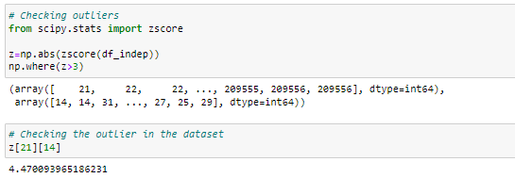
Checking for outliers
We can see outliers are present in the dataset.

Slide 35
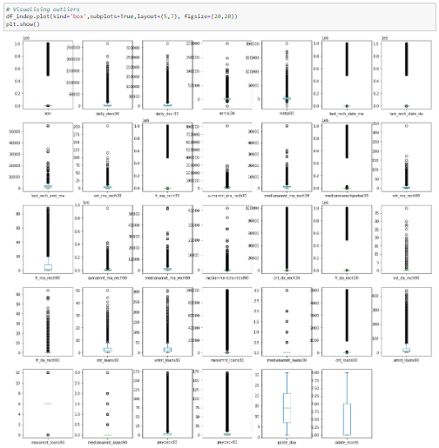
Visualizing outliers
Plot showing there are presence of outliers in the columns : 'daily_decr30', 'daily_decr90', 'rental30', 'rental90', 'last_rech_amt_ma', 'cnt_ma_rech30', 'sumamnt_ma_rech30', 'medianamnt_ma_rech30', 'cnt_ma_rech90', 'sumamnt_ma_rech90', 'medianamnt_ma_rech90', 'medianmarechprebal90', 'cnt_da_rech90', 'fr_da_rech90'.

Slide 36
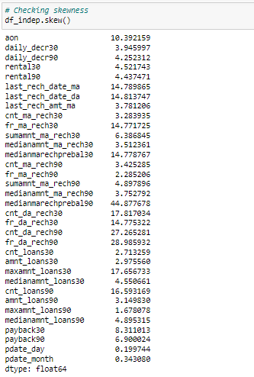
Checking skewness
Skewness is present in the dataset as acceptable range is +/-0.5, but here we can see high skewness so we can change the threshold as per the kind of data distribution in particular column.

Slide 37
Data Cleaning
Data Cleaning means the process of identifying the incorrect, incomplete, inaccurate, irrelevant or missing part of the data and then modifying, replacing or deleting them according to the necessity. Data cleaning is considered a foundational element of the basic data science. The process includes :
Removing outliers
Removing skewness

Slide 38
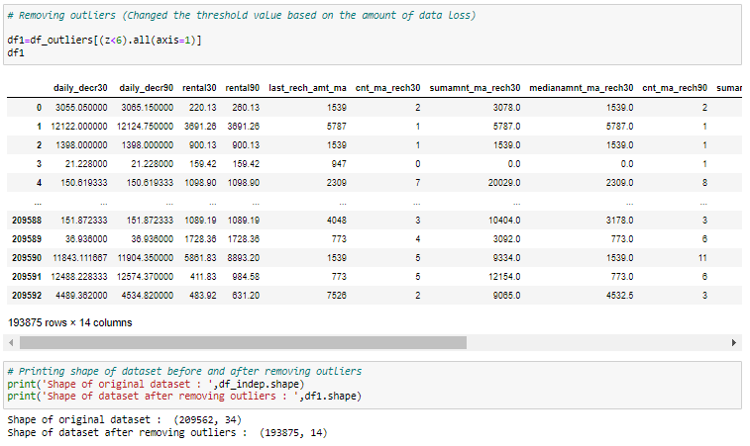
Removing outliers
Approx 7% data is lost after removing the outliers.

Slide 39
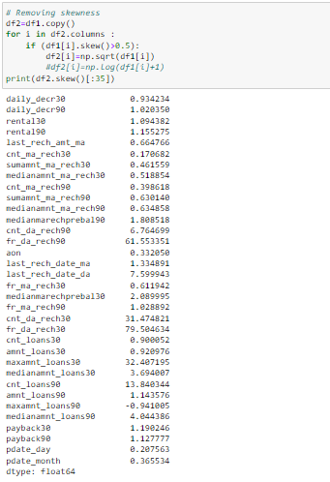
Removing Skewness
Removed skewness from all columns but in columns fr_da_rech90, cnt_da_rech30, fr_da_rech30 no significant change is seen on further removing skewness due to the kind of data distribution. Hence we can consider the present values as skewness threshold.

Slide 40
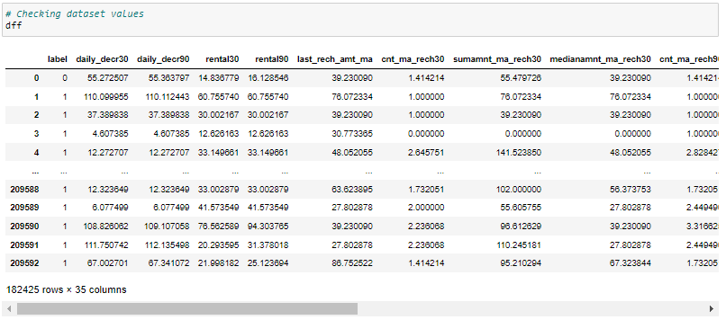
Final Dataset

Slide 41
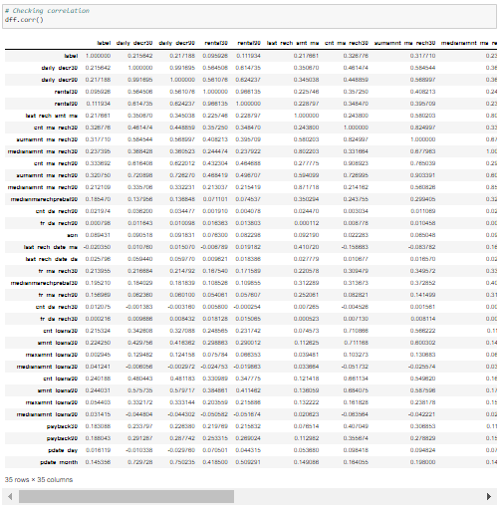
Checking Correlation

Slide 42
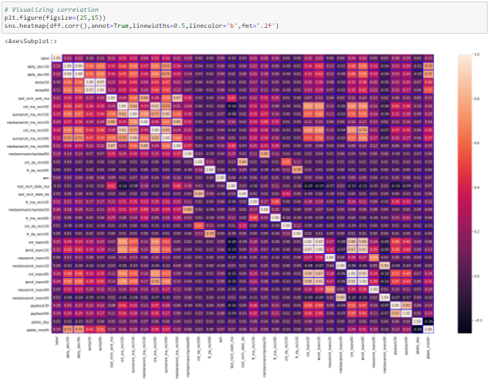
Visualizing correlation

Slide 43
Inferences from correlation
Columns 'daily_decr30', 'daily_decr90', 'last_rech_amt_ma', 'cnt_ma_rech30', 'sumamnt_ma_rech30', 'medianamnt_ma_rech30', 'cnt_ma_rech30', 'cnt_ma_rech90' has good correlation with target column 'label'.
'rental30' has strong positive correlation with 'daily_decr30', 'daily_decr90'. 'rental90' has strong positive correlation with 'daily_decr30', 'daily_decr90'. 'last_rech_amt_ma' has good correlation with 'daily_decr30', 'daily_decr90', 'rental30', 'rental90'. 'cnt_ma_rech30' has good correlation with 'daily_decr30', 'daily_decr90', 'rental30', 'rental90', 'last_rech_amt_ma'. 'sumamnt_ma_rech30' has strong correlation with 'daily_decr30', 'daily_decr90', 'last_rech_amt_ma', 'cnt_ma_rech30'. 'medianamnt_ma_rech30' has very strong postive correlation with 'last_rech_amt_ma' and 'sumamnt_ma_rech30'. 'cnt_ma_rech90' has good/strong positive correlation with 'daily_decr30', 'daily_decr90', 'rental30', 'rental90', 'last_rech_amt_ma', 'cnt_ma_rech30', 'sumamnt_ma_rech30', 'medianamnt_ma_rech30'. 'sumamnt_ma_rech90' has good/strong positive correlation with 'daily_decr30', 'daily_decr90', 'rental30', 'rental90', 'last_rech_amt_ma', 'cnt_ma_rech30', 'sumamnt_ma_rech30', 'medianamnt_ma_rech30', 'cnt_ma_rech90'. 'medianamnt_ma_rech90' has good/strong positive correlation with 'daily_decr30', 'daily_decr90', 'rental30', 'rental90', 'last_rech_amt_ma', 'cnt_ma_rech30', 'sumamnt_ma_rech30', 'medianamnt_ma_rech30', 'cnt_ma_rech90','sumamnt_ma_rech90'. 'fr_da_rech30' has strong correlation with 'fr_da_rech90'. 'pdate_month' has strong correlation with 'daily_decr30', 'daily_decr90', 'rental30', 'rental90' and good coorlation with few other columns. Many independent columns have strong correlation with each other hence problem of multicollinearity exists here.

Slide 44
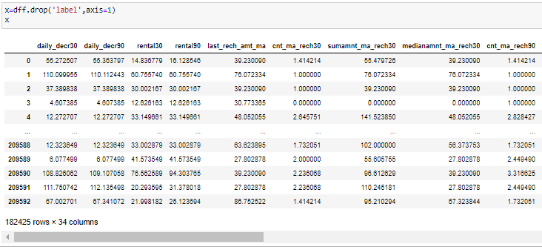
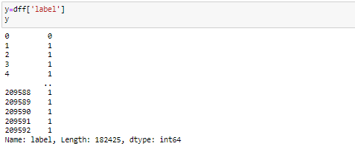
Dividing dataset in x and y

Slide 45
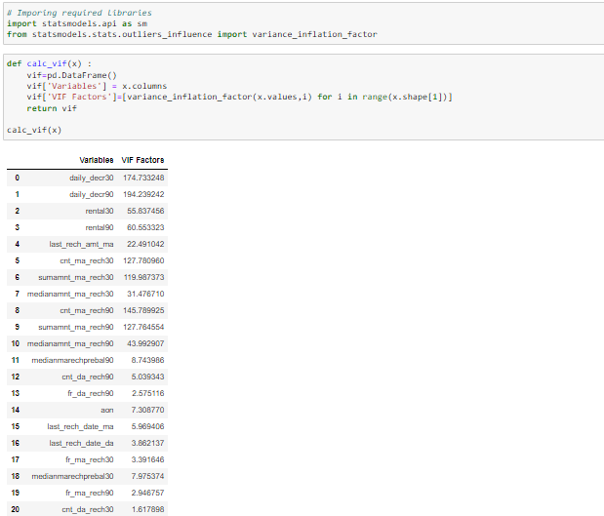
Multicollinearity with VIF
Checked and dropped the high multicolinear columns

Slide 46
In dataset, among multicolinear columns the features that are contributing less to the output variable can be dropped.
We can drop 2-3 columns showing high co-linearity but not all as it impacts the output.
Machine learning needs refined dataset.
It needs only those columns that are highly contributing to the output. Clean data for which EDA is used. This is for better learning and prediction of data by models.
Once refining is done we'll do Standard Scaler to make all data scaled to mean=0 and std.dev.=+-1, so that prediction could be nearby.

Slide 47
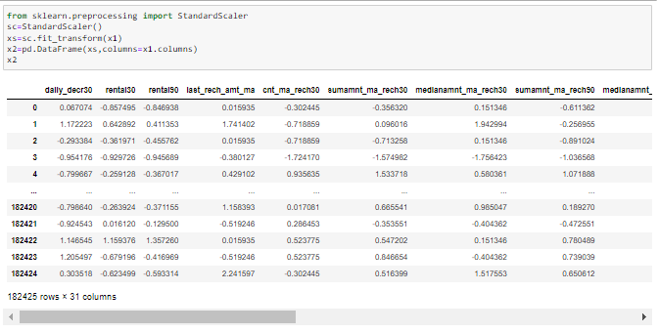
Scaling : Standard Scaler / Min-Max Scaler
Scaling is done for making data points generalized so that the distance between them will be lower.

Slide 48
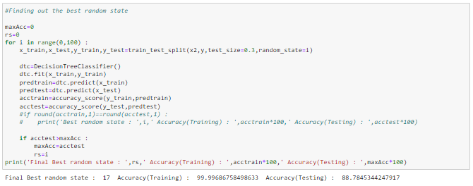
Find best random state for Train-Test Split
Here, we are getting good accuracy for random state=17. So, lets take 17 as our best random state.

Slide 49
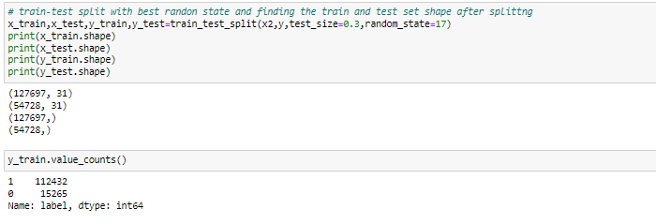
Train-test split with best random state and finding the train and test set shape after splitting
Huge difference is there in both classes of training set hence class balancing is required here before model training.

Slide 50


Class Imbalance
Resampling is done on training dataset as sampling on whole dataset will create unnecessary testing and validation sets which will give misleading results.

Slide 51
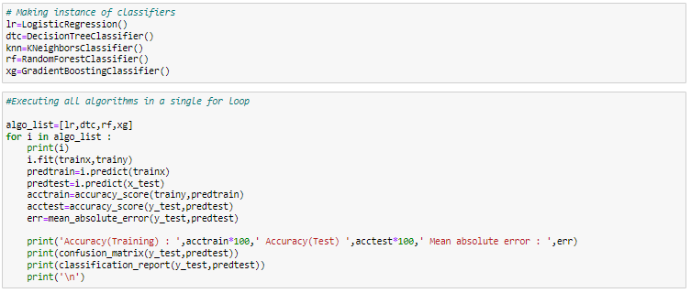
Finding the best algorithm
Model Building
We are using 4-5 models for training and testing.

Slide 52
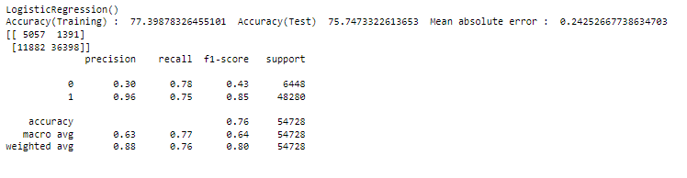
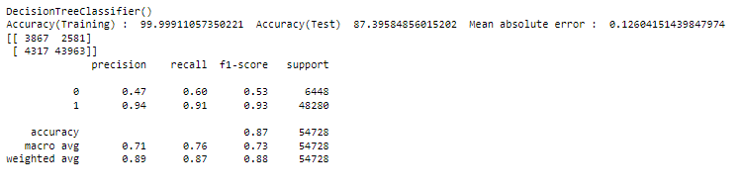
Accuracy and evaluation metrics of the models used
Logistic Regression
Decision Tree Classifier

Slide 53
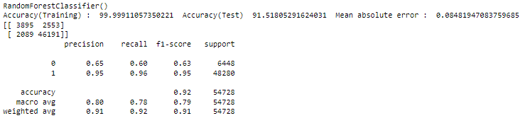
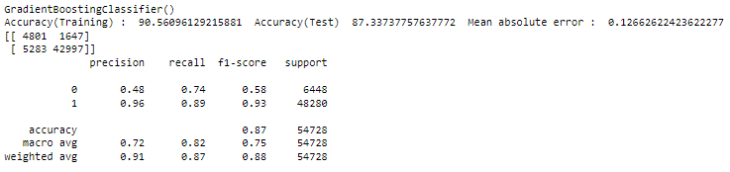
Accuracy and evaluation metrics of the models used
Random Forest Classifier
Gradient Boosting Classifier

Slide 54
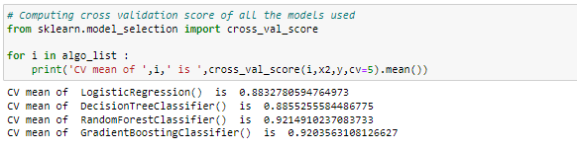

Cross validation
Looking at difference of accuracy and cv mean, opting for RandomForestClassifier() as our best model with accuracy of 92% and having least difference between accuracy and cv mean.

Slide 55

Hyper parameter Tuning
Using hyper parameter tuning for better accuracy and to avoid over fitting issues with best parameters on selected model.

Slide 56

Hyper parameter tuning with best parameters
We are getting model accuracy as 91% and cv mean as 0.92, this shows our model is performing good.

Slide 57


AUC-ROC Curve
Applying AUC-ROC curve on selected model i.e. RandomForestClassifier()
Calculating fpr, tpr, thresholds for selected model

Slide 58


Plotting AUC-ROC Curve
Getting good accuracy score and AUC-ROC score for the model selected

Slide 59

Saving the model
Saving the model selected using pickle in pickle file to convert it into byte stream.
This is called Serialization.

Slide 60


Conclusion

